Slide 1
Process Flow – Data Cleaning and Modelling
Post the implementation of Exploratory Data Analysis (EDA) techniques to gain insights on the data features, the data was prepared for modelling purposes.

Slide 2
Steps performed for data preparation and modelling
Data post EDA
Data Sampling
Train-Test split
Data Pre-Processing
Bag of words
Data Pre-Processing
Word Embeddings
Modelling
Modelling
Implementing machine learning models
Implementing deep learning models
Backend server handling

Slide 3
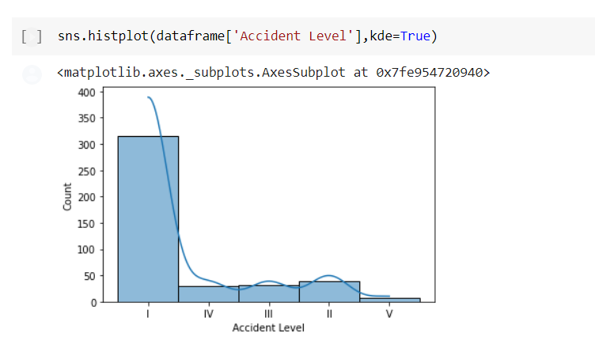
Post EDA Insights - Summary
Post getting the following insights from Exploratory Data Analysis (EDA) certain insights were derived to go about the pre-processing of specific features in the dataset.
1. Data was found to be highly imbalanced.
2. Some training features were also found to be highly imbalanced. Example: Genre column had a high imbalance with majority of the values as male.
3. Critical risk column acted as a column similar in its utility to the description column. The column appeared to be more of a textual rather than a categorical feature.
Class imbalance of target column

Slide 4
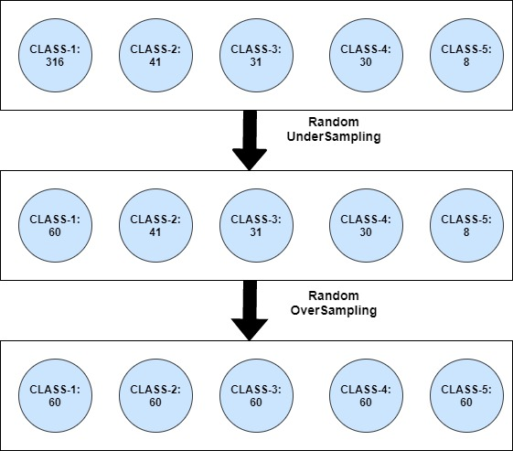
Sampling
Need for resampling in our dataset
Due to the highly imbalanced classification of target variable with the majority of the values for Accident level feature being for class I, various resampling methods were applied to improve learning rate for minority classes and remove bias
Techniques implemented
Sampling technique used on the dataset is a conjunction of random under-sampling and random oversampling. Other techniques tested were CNN (Condensed Nearest Neighbours), Tomek Link and SMOTE
Resampling methods are designed to change the composition of a training dataset for an imbalanced classification task.
Representation of sampling technique used

Slide 5
Data Pre-processing: Bag of Words – Machine Learning Model
1. Features such as Countries, Industry Sector were label encoded.
2. Features such as Potential Accident Level, Date of Incident were ordinal encoded.
3. Feature Local was binary encoded.
Handling Textual Data:
Feature critical risk and description were merged to create larger corpus.
Stop words, punctuations, emoticons etc. were removed during initial cleaning.
TF-IDF vectorizer was used to find the top words for the bag of words model. The following parameters were set for the bag of words model:
max_features: - 2000
max_df: -0.9
ngram_range:- (1,3)

Slide 6
Data Pre-processing: Word Embeddings – Deep Learning Model
1. Features such as Countries, Industry Sector were label encoded.
2. Features such as Potential Accident Level, Date of Incident were ordinal encoded.
3. Feature Local was binary encoded.
Handling Textual Data:
Feature critical risk and description were merged to create larger corpus.
Stop words, punctuations, emoticons etc. were removed during initial cleaning.
After initial cleaning all words were tokenized and padded.
Glove Embeddings technique was used to create Embeddings vectors for the textual data. It is done by creating an embedding layer at the start of the neural network architecture. The following parameters were kept during embedding:
Embedding Size: - 200
Max Length: -137
Max Features :- 30,000(approximately)

Slide 7
Modelling: Machine Learning
The pre-processed and cleaned training data is then passed on to various machines learning models.
Models trained on dataset:
Regression Based Algorithms
Logistic Regression
Instance Based Algorithm
K-nearest Neighbour
Support Vector Machine
Decision Tree Algorithms
CART
Bayesian Algorithms
Naïve Bayes
Ensemble Algorithms
Bagging
Random Forest
Stacking and Voting Classifiers
Boosting
Ada Boost
Gradient Boost
XG- Boost
Reference: -https://machinelearningmastery.com/a-tour-of-machine-learning-algorithms/

Slide 8
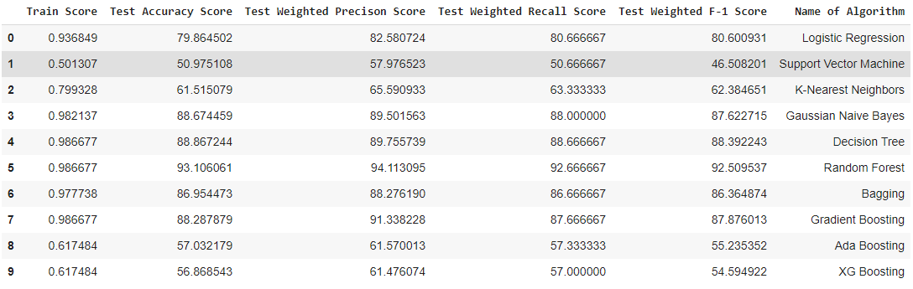
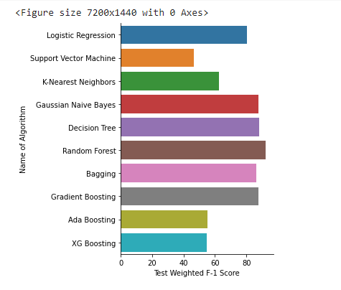
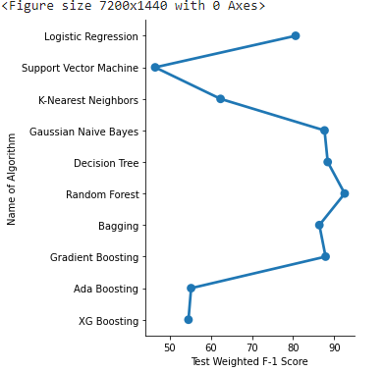
Results and Analysis: Default Classifiers

Slide 9
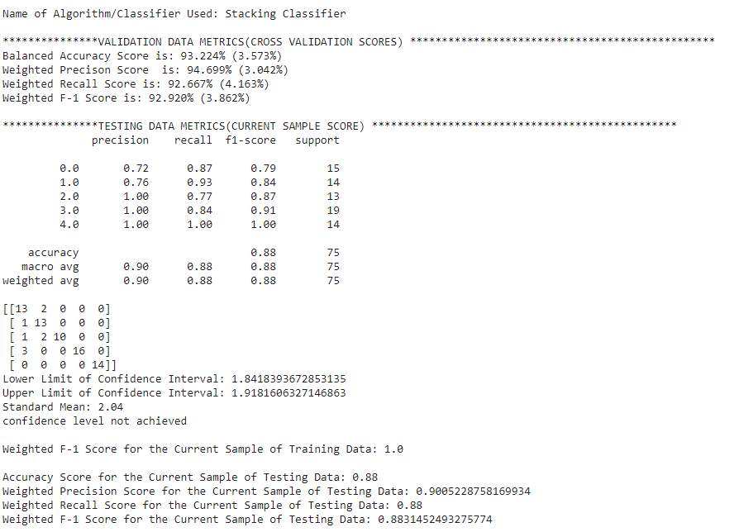

Slide 10
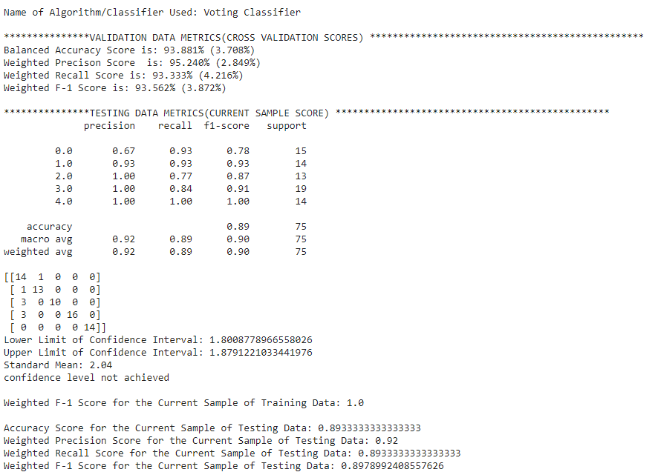

Slide 11
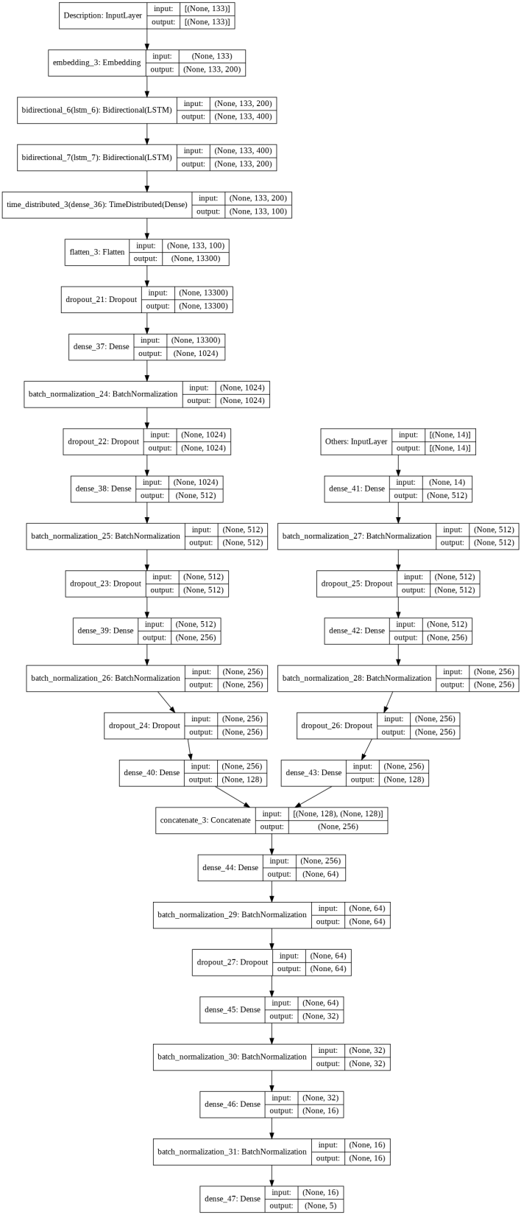
Modelling: Deep Learning
The pre-processed and cleaned training data is then passed on to deep learning model. The architecture of the model is:
The following are the parameters of the neural network:
Loss Function: Sparse_Categorical_Entropy
Validation Metric: Accuracy
Epochs: 50
Batch Size: 32
Optimizer: Adam
Learning Rate: 0.001
Callbacks: ModelCheckpoint, ReduceL RonPlateau
Reference: -https://machinelearningmastery.com/a-tour-of-machine-learning-algorithms/

Slide 12
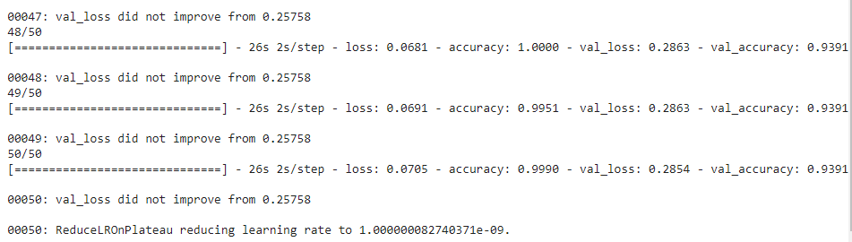
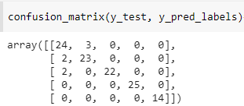
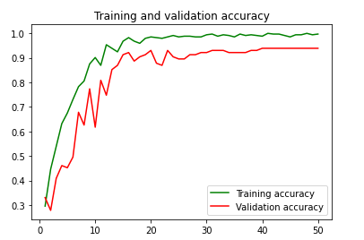
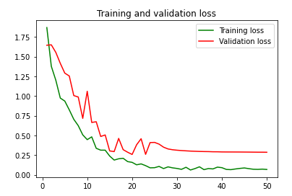
Results and Analysis

Slide 13

Final Deployment
Finally all the models, encoders and vectorizers were exported using pickle, and the best model was kept in the backend for deployment.
Fig:- Dumping the Model on the Drive
Future Scope for Data Cleaning and Modelling
Fig: - Loading the Encoder in the Backend
The following are the future scopes on the modeling process:
Using Attention Models and Transformers
Using BERT and XLNET
Bootstrap Aggregation with LSTM
Stacking and Voting with LSTM
Bayesian Hyper Parameter Optimization
Perform advanced Data Cleaning Techniques on Dataset
Perform advanced Feature Selection.
Perform NLG techniques to increase data.

Slide 14
ANY QUESTIONS ?
Thank You!

